Slide 1
Django Tutorials
By Saurav Singh

Slide 2
In Terminal
Pip install Django – This will install django
Django-admin startproject mysite – This will create a project folder
Python manage.py runserver – This will run our project and give a port.
python manage.py migrate – This will fix the warning.
Create a file view.py in mysite folder.

Slide 3
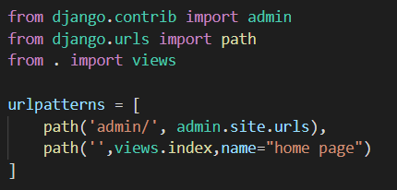
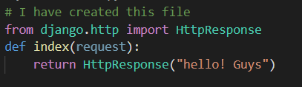
Views and URLs
views.py
Urls.py
First the programs checks URLs.py and then according to the path it goes in views.py and access the function index

Slide 4
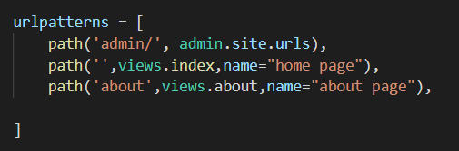
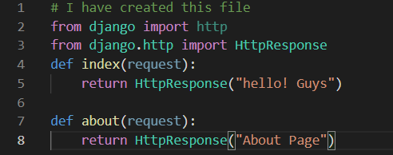
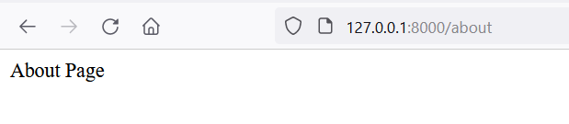
Pipelining
Urls.py
views.py
If you enter admin you get redirected to admin page or if you enter about you get redirected to about page

Slide 5
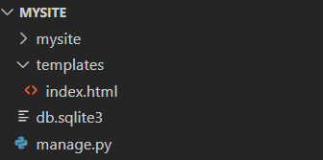

Django Templates
Separating HTML page and connecting it to the views page.
Settings.py>TEMPLATES>DIRS = ‘templates’.- we are telling Django that we have a folder(which we will create) templates and we are going to use that.
Create a folder templates>index.html in which manage.py is there.
Views.py>from Django.shortcuts import render.
Instead of return use – return render(request,index.html)

Slide 6
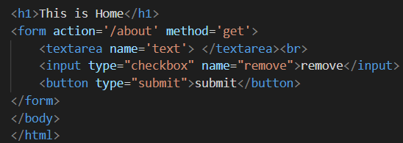
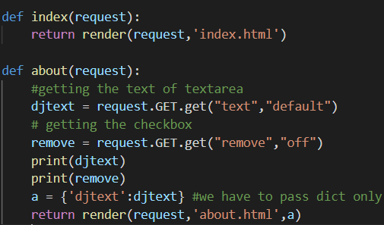
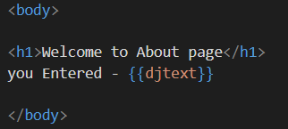

Forwarding data to next page
Suppose you want to forward your data of home page to about page.
Index.html
Urls.py
About.html

